Slide 1
Team 7- Project Milestone 2 (Medium vs Small mammals)
Ching-min Hu; Qiao Liu; Dandan Zhao; Rajasree Rajendran;
Megha Rao; Fernanda Bordin - CMPE257- Spring 2019
Notes:
‹#›

Slide 2
Presentation Outline
1)What is your ML algorithm Design for this milestone
2) Show your prediction score on one pair of selected testing data not exposed to the model during training.
3) List 6 random images with original and predicted labels
4) Use confusion matrix and classification report to analyze your binary classification result
6) Summarize prediction performance your 5x5 =25 trials result in a chart
7) Lesson learned
8) How you improved your work.

Slide 3
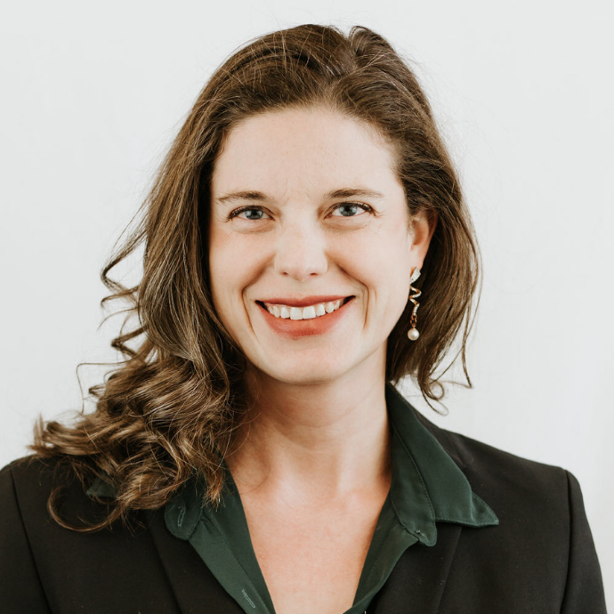
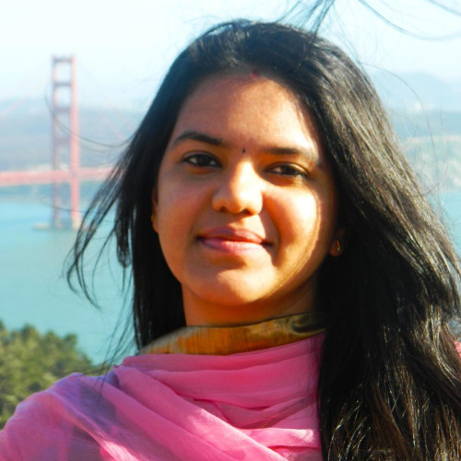
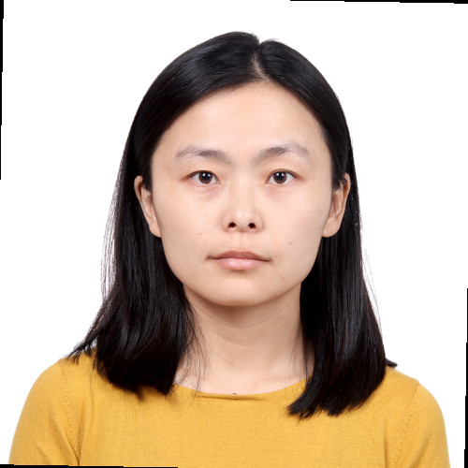
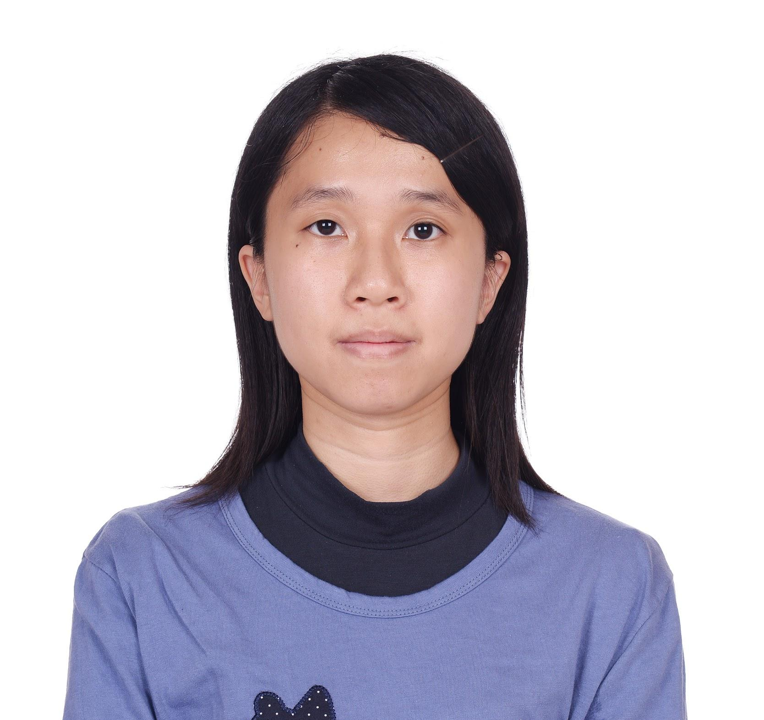
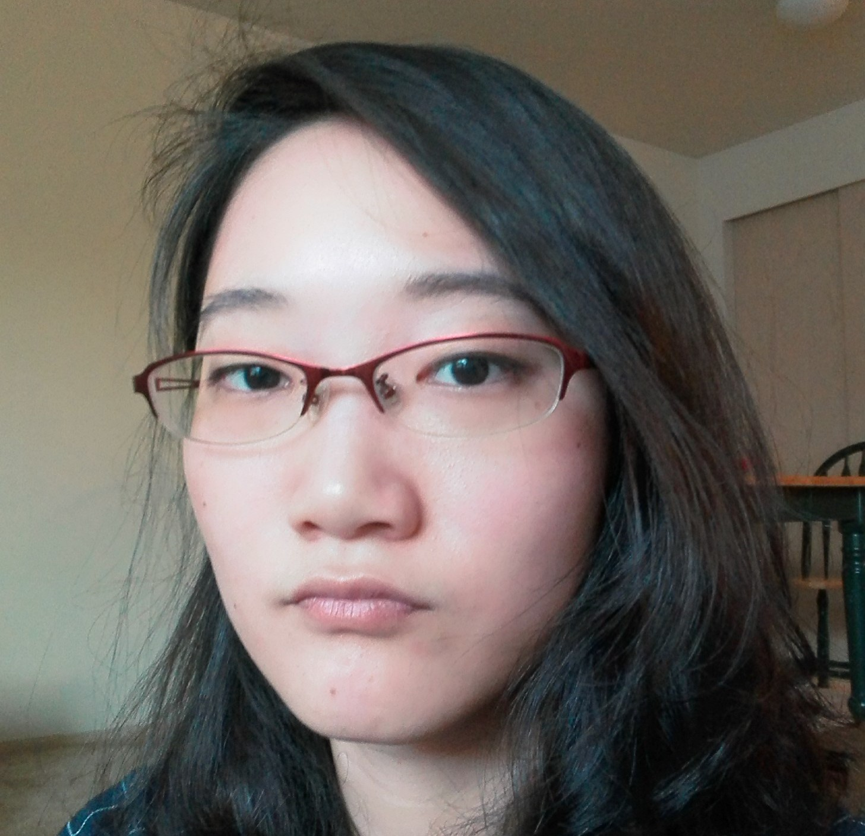
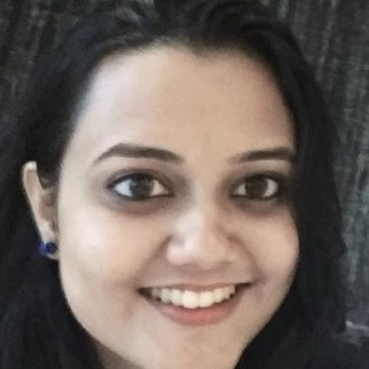
Group Members
Fernanda Bordin
Rajasree Rajendran
Dandan Zhao
Ching-min Hu
Qiao Liu
Megha Rao

Slide 4
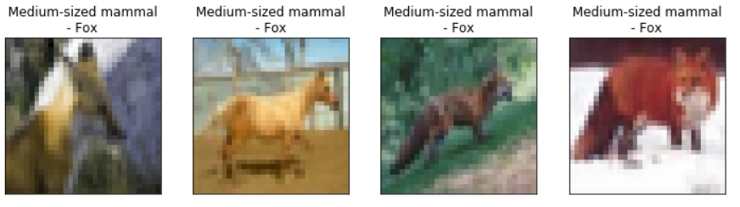
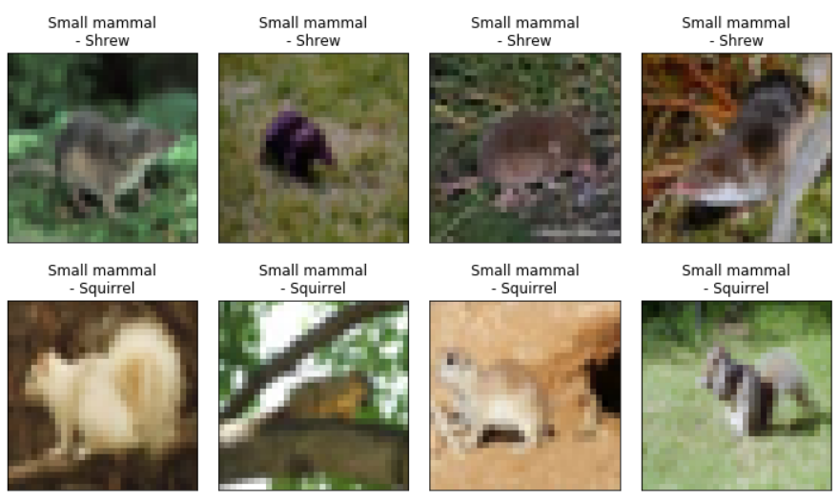
Data Preparation
Print 4 random images from each class

Slide 5
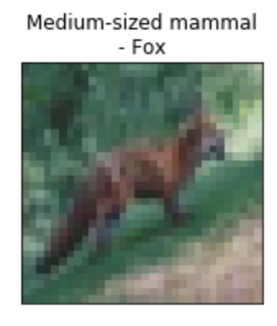
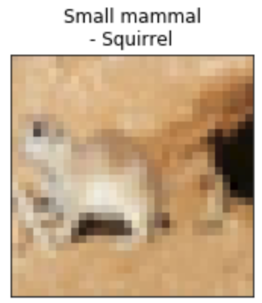
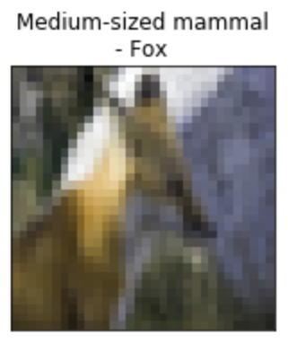
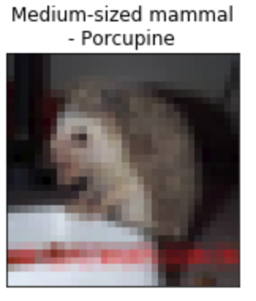
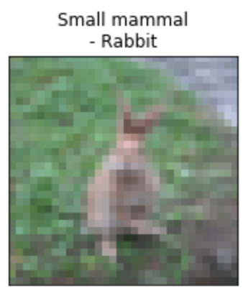

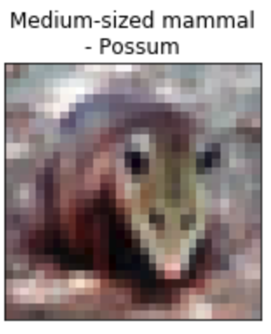
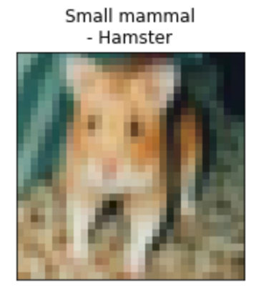
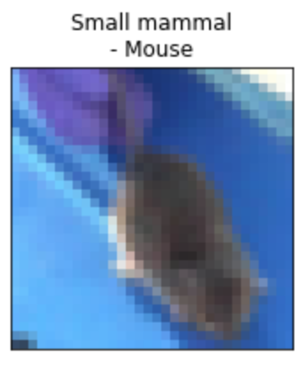
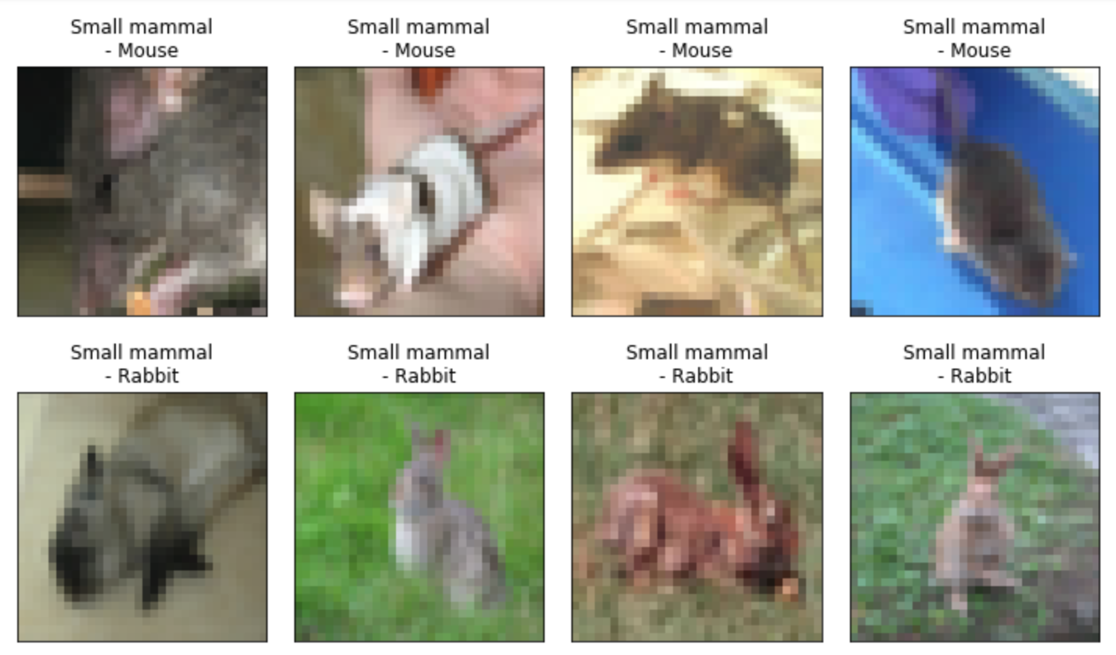
Data Preparation (Milestone 2)
2 Classes as Testing set:
Eg: Fox (medium) & Squirrel (small)
ML / NN models
2 superclasses:
Small & Medium Mammals
Prediction:
Small or Medium Mammal
Training set:
Remaining 8 classes
- 25 pairs total

Slide 6
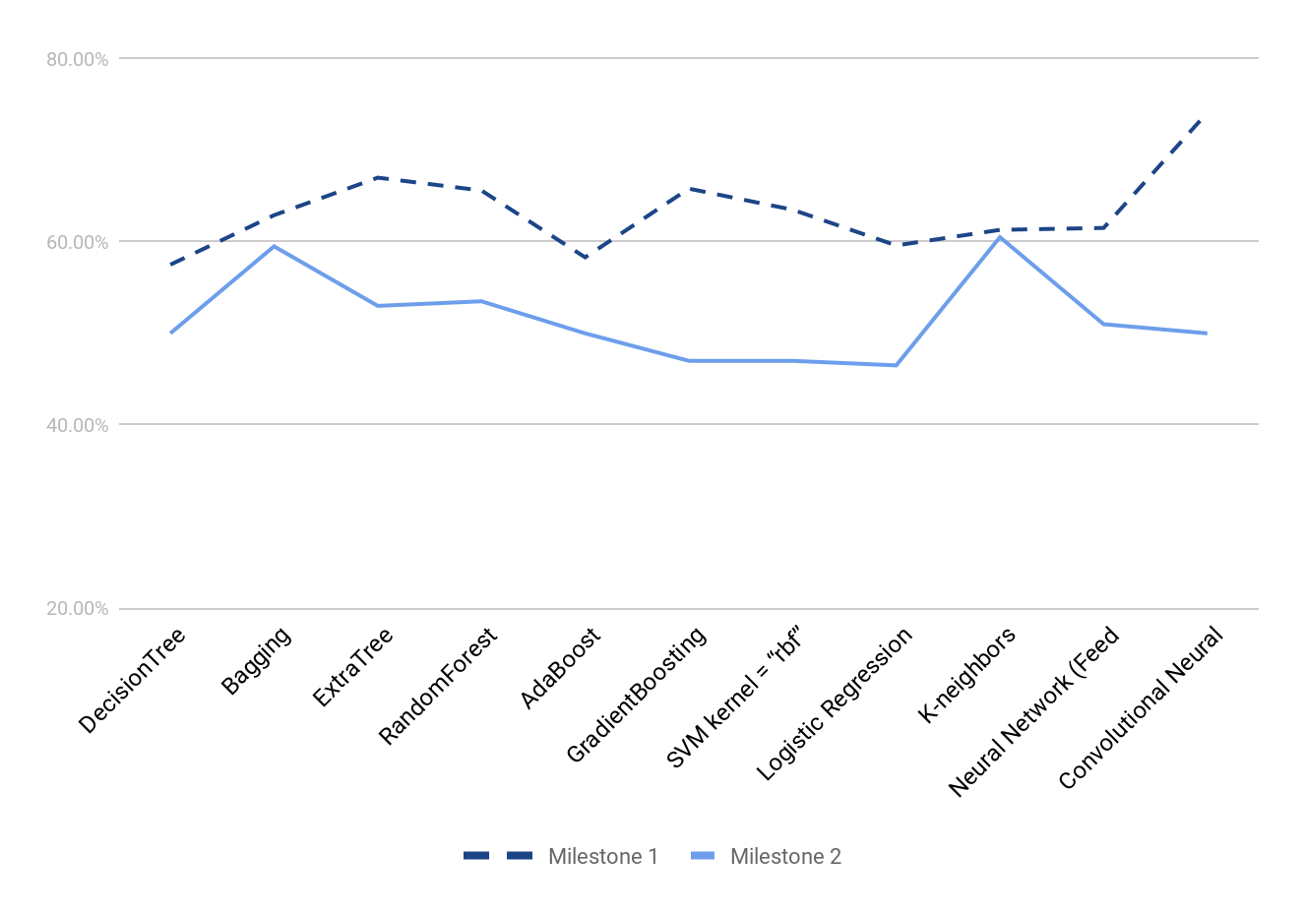
Comparison between score results for Milestone 1 and 2

Slide 7
KNN
Method: GridSearch, CV = 5
n_neighbors: 1~10,20,50,100,200,500,1000
weights: ‘distance’, ‘uniform’
Best parameters Found: 'n_neighbors': 8, 'weights': 'distance'
Accuracy Score: 60.5%
Milestone1 accuracy: 61.3%

Slide 8
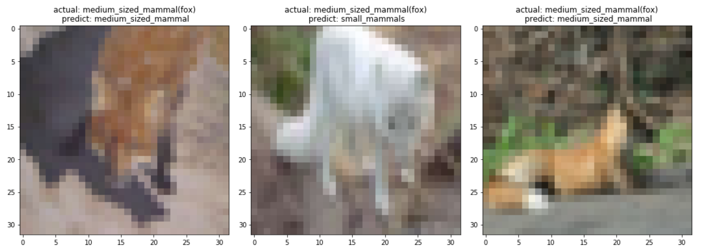
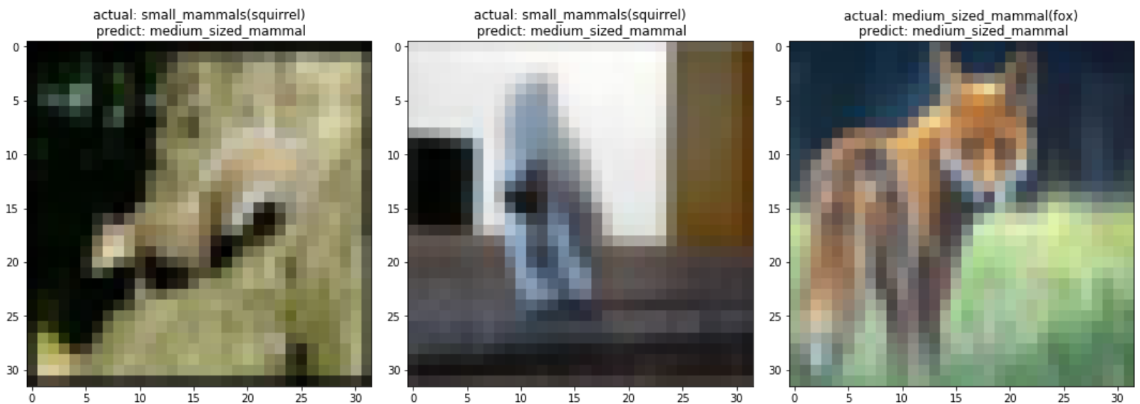
Predictions

Slide 9
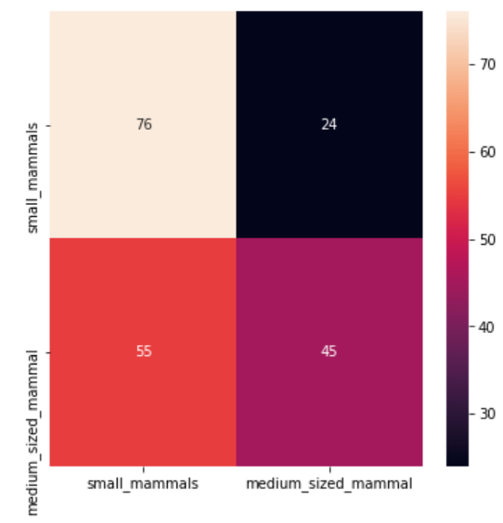
Confusion matrix

Slide 10
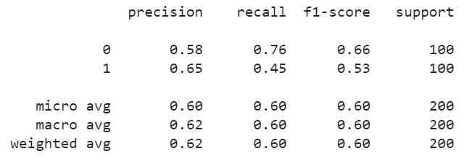
Classification report

Slide 11
The results of 25 trials
(avg = 55.34%, median=55%)
Missing Pair | Score | Missing Pair | Score
hamster & fox | 59% | rabbit & fox | 52.50%
hamster & porcupine | 59.50% | rabbit & porcupine | 59.50%
hamster & possum | 56.00% | rabbit & possum | 52.00%
hamster & raccoon | 57.50% | rabbit & raccoon | 54.50%
hamster & skunk | 56.00% | rabbit & skunk | 49.50%
mouse & fox | 51.00% | shrew & fox | 48.00%
mouse & porcupine | 52.50% | shrew & porcupine | 52.50%
mouse & possum | 54.50% | shrew & possum | 49.50%
mouse & raccoon | 55.00% | shrew & raccoon | 55.50%
mouse & skunk | 51% | shrew & skunk | 53.00%
squirrel & porcupine | 65.50% | squirrel & raccoon | 60.50%
squirrel & possum | 59.00% | squirrel & skunk | 59.50%

Slide 12
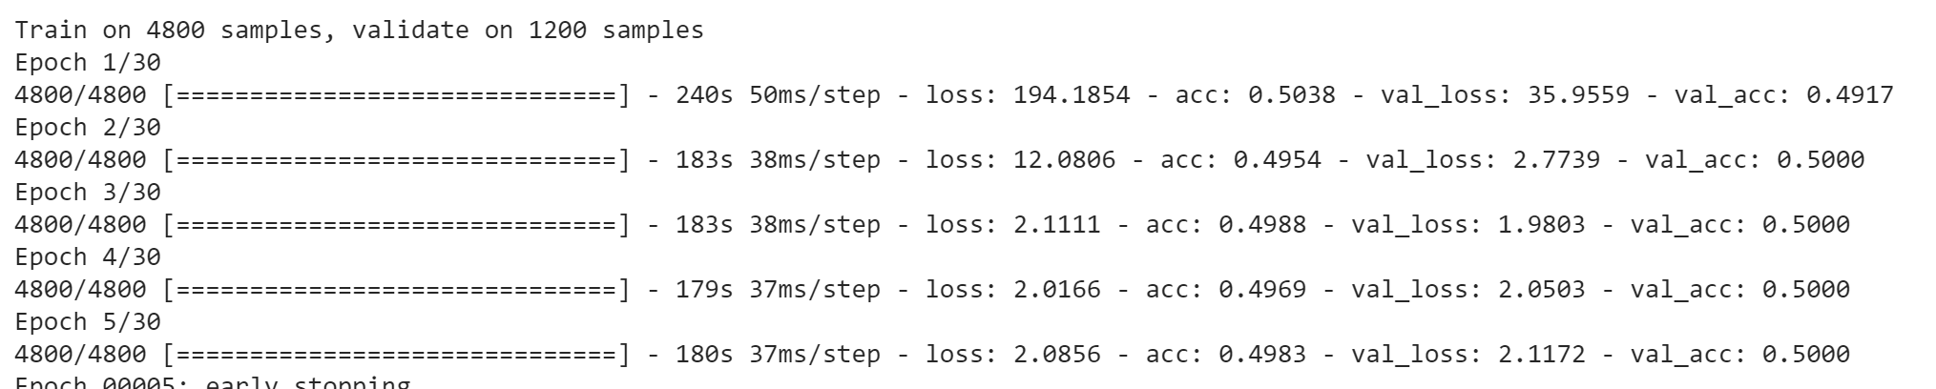
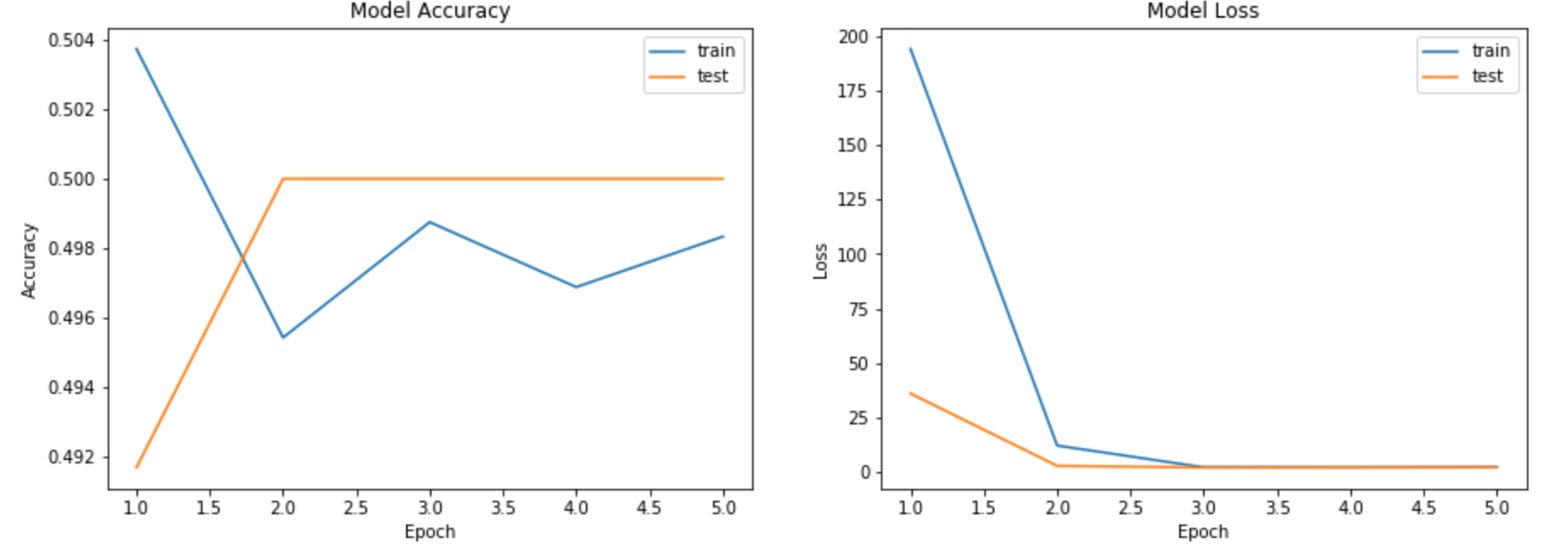
Looking for a more effective CNN model, we explored DenseNet121, ResNet….

Slide 13
Neural Networks tried
Image Preprocessing: sliding and rotating
DenseNet, CNN:
squirrel vs. fox: 50%
Slightly better results for different pairs:
racoon vs. mouse: 57.33%
Next Steps:
Fuzzy learning, RNN, VGG-16
Test different pairings

Slide 14
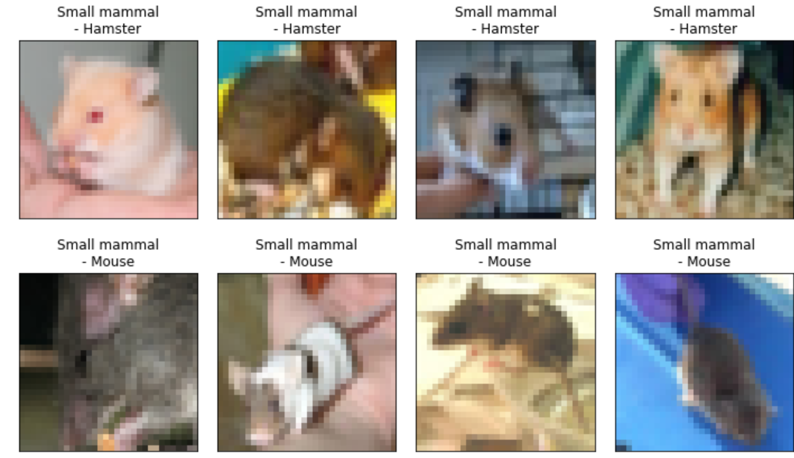
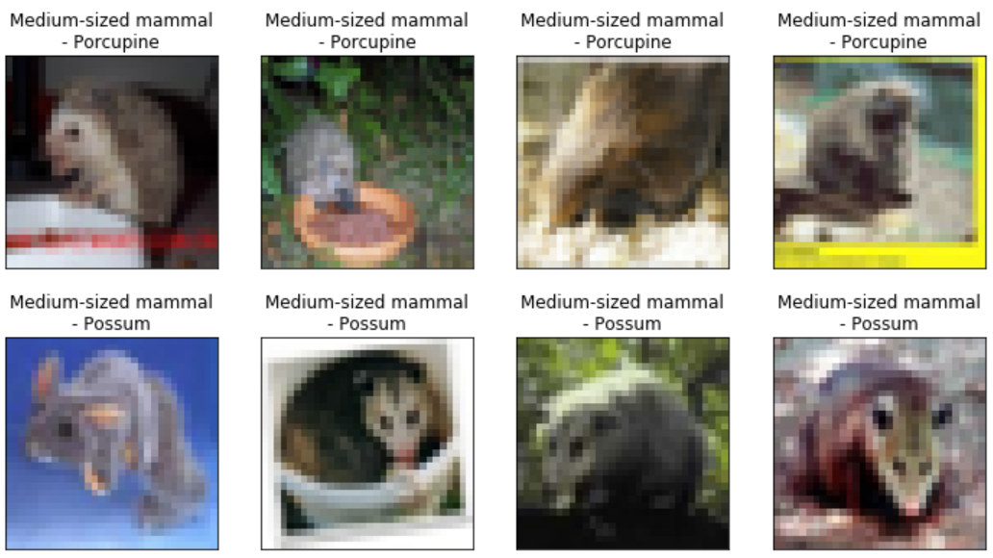

Slide 15
Lessons Learned
Data is the most important
Sometimes simple models work better than Neural Networks
When searching for pretrained models, understand it first, then run it
Robustness of our model is more important than scores

